Slide 1

Analysis of Medical Costs and Influencing Factors
A data-driven exploration into the factors driving medical expenses.
We uncover actionable insights for healthcare professionals, insurers, and policymakers.
By: Md Aamir Nawab
1

Slide 2

Objective and Methodology
Objective
Methodology
To analyze key factors influencing medical costs.
Statistical analysis and data visualization were done.
Identify trends and provide data-driven recommendations.
Focus on correlations and patterns of costs.
2

Slide 3
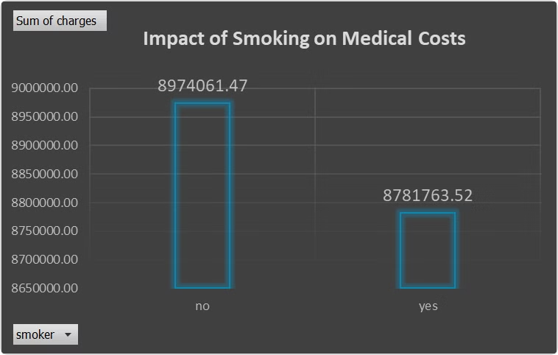
Smoking Impact Analysis
1
Lower Total Costs
Smokers have counterintuitively lower costs.
2
Insight
Smaller sample or early mortality is a possibility.
3
Action
Further research on long-term costs is needed.
3

Slide 4
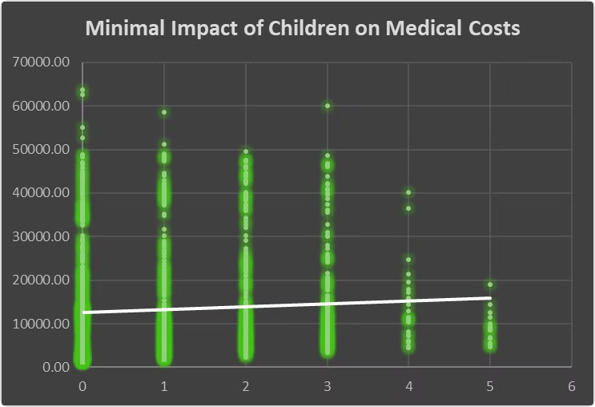
Children vs. Medical Costs
1
Minimal Impact
2
Key Insight
Number of children shows little correlation to costs.
Other factors have a stronger influence.
3
Action
Focus on factors with stronger impact on
medical expenses.
4

Slide 5

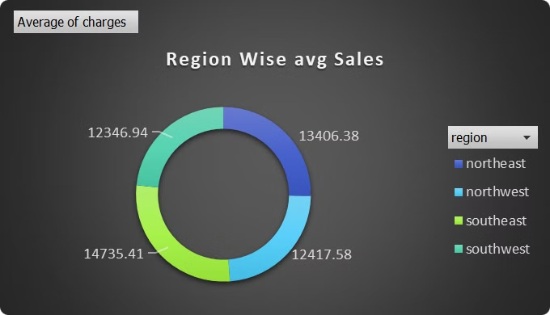



Regional Cost Comparison
Southeast
Southwest
Key Insight
Highest average medical costs were found here.
Lowest average medical costs were seen here.
Regional factors contribute to cost differences.
5

Slide 6

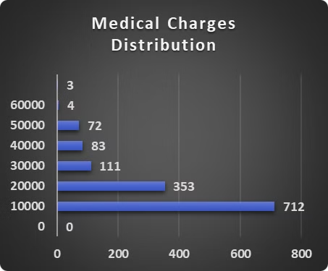
Distribution of Medical Charges
1
Common Range
Most medical charges fall within the $0-$10,000 range.
2
Cost Majority
Charges are below $20,000 for the majority of people.
3
Action
Use insurance for high-cost cases.
6

Slide 7
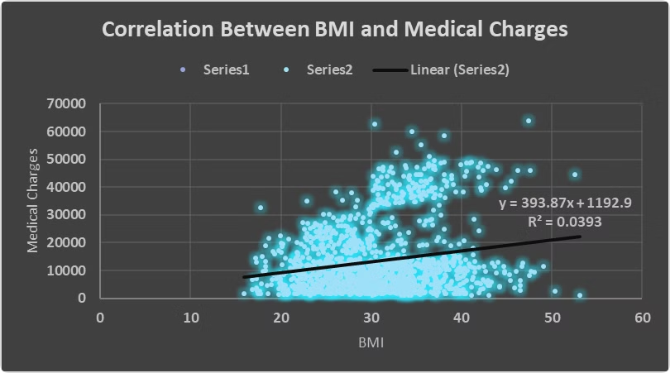
BMI and Medical Charges
Negligible Correlation
Key Insight
Data does not support a strong relationship.
Common belief not supported by data.
Action
Segment data by variables like health conditions.
7

Slide 8

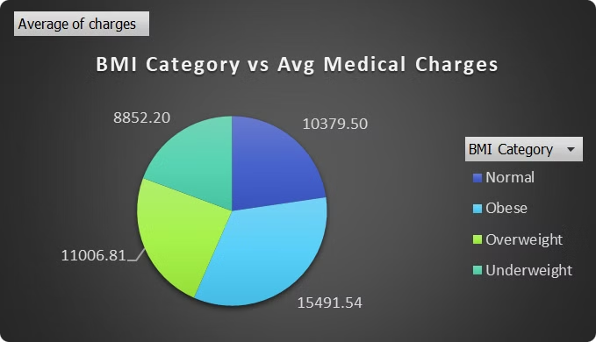



Medical Costs Across BMI Groups
Obese Individuals
Contribute significantly more to total costs.
Key Insight
Obesity drives up healthcare expenses.
Action
Health programs for weight management can help.

Slide 9

Link for the Video:
https://youtu.be/X300ggZBk-k
Thank you!
8

